Slide 1
Netflix Customer Support Assistant:
A RAG-Based AI Solution
RAG REAL-LIFE USE CASE
AI Engineer — Tanishq Rawat
Groq · gpt-oss-120b
all-MiniLM-L6-v2
Chroma
Streamlit
Notes:
OPENING (about 30 seconds)
- Introduce the engagement: an AI consultant's proof-of-concept for a Netflix customer-support assistant built with Retrieval-Augmented Generation (RAG).
- The assistant is called Ava. It answers only from approved help-center content and shows the evidence behind every answer.
- PRESENTER CHECK: replace [Your Name] and [Date] on this slide before presenting.

Slide 2





Business Use Case
BUSINESS CASE
THE PROBLEM
THE SOLUTION
EXPECTED VALUE
Repetitive ticket volume
Ava, a RAG support assistant
Faster, consistent, auditable
High ticket volume for billing, account and streaming questions that already have documented answers.
Answers grounded strictly in Netflix Help Center documents, delivered in Netflix's support Chat.
Quicker resolution, consistent brand voice, visible sources and lower hallucination risk than a bare LLM.
Why a grounded assistant beats an unrestricted chatbot
Unrestricted chatbot
Ava — grounded RAG
Answers from general training data
Answers from approved Help Center content
May invent plans, prices or policies
Refuses when the context is insufficient
No way for the user to verify a claim
Shows retrieved chunks to verify answers
Value statements are expected benefits; no production ticket-volume, response-time or cost metrics were measured.
Notes:
PROBLEM -> SOLUTION -> VALUE
- Support teams spend a large share of effort on repetitive billing, account and streaming questions whose answers already exist in help-center documentation.
- Ava is a RAG assistant: it retrieves relevant passages from the knowledge base first, then writes an answer constrained to those passages.
- Why not a plain chatbot? A general LLM answers from training data and can state wrong plans, prices or policies with confidence. Grounding plus visible sources makes answers auditable.
- Be careful with wording: the benefits (faster resolution, lower cost) are EXPECTED, not measured in this project. Grounding reduces hallucination risk; it does not guarantee zero hallucination.

Slide 3


System Architecture
ARCHITECTURE
OFFLINE · INDEXING PIPELINE
Knowledge docs
4 unstructured .txt files in data/
Load & chunk
Recursive splitter · 500 chars / 80 overlap
Embed
all-MiniLM-L6-v2 · 384-d vectors
Chroma
local vector database
Built ahead of time. At query time only the user's question is embedded and compared with the stored vectors.
vector search
ONLINE · QUERY & RESPONSE
Access requires Mock Login
Mock Login
session-based gate in front of the engine
User query
typed in the Streamlit chat
Query embedding
same MiniLM model
Top-k retrieval
similarity search in Chroma
Prompt assembly
Ava persona + answer format + retrieved context
LLM generation
Groq · openai/gpt-oss-120b
Streamlit UI
Retrieval Reasoning + Answer + Retrieved Chunks
Generation: Groq openai/gpt-oss-120b (primary configuration). Alternative provider option: OpenAI gpt-4o-mini. Retrieved chunks are always displayed so answers can be verified.
Notes:
HOW TO READ THE DIAGRAM
- Top lane (offline): the four documents are loaded, split into 500-character chunks with 80 characters of overlap, embedded with all-MiniLM-L6-v2 into 384-dimensional vectors, and stored in a local Chroma database. This is done ahead of time.
- Bottom lane (online): after Mock Login, the user's question is embedded with the same model, the top-k most similar chunks are retrieved from Chroma, and the prompt (Ava persona + answer format + retrieved context) is sent to the LLM. The UI shows Retrieval Reasoning, the Answer, and the Retrieved Chunks.
- The dashed red boundary shows that the whole RAG engine is only reachable after login.
- Retrieval quality and generation quality are separate: if the wrong chunks are retrieved, even a strong LLM cannot answer correctly from them.
- PRESENTER CHECK: confirm in the code which provider is the default (Groq vs OpenAI). The deck shows Groq gpt-oss-120b as primary and gpt-4o-mini as an alternative option; it does not claim both run at once.

Slide 4

Model Choice: LLM vs. SLM
MODEL SELECTION
Criterion | Large model (selected) | Small model (alternative)
Instruction following | Stronger on multi-rule prompts (persona + format + refusal) | More likely to drift; needs testing
Response quality | Fluent; handles ambiguous questions | Fine for short, narrow answers
Context handling | Long window holds many chunks (131K here) | Often shorter windows, fewer chunks
Latency | Heavier compute; fast hosted inference keeps chat responsive | Lowest latency
Cost | Per-token API cost | Cheaper; can be self-hosted
Deployment & privacy | Hosted API: prompt and retrieved text leave the app | Can run fully local or on-prem
Fit for grounded support | Chosen: reliable refusals and retrieval rationale | Plausible; validate on the eval set
EMBEDDINGS · SMALL ENCODER (SLM-CLASS)
all-MiniLM-L6-v2
≈22.7M parameters, 384-d vectors
Local, free and fast; keeps data local
Embeds text only; never writes answers
GENERATION · LARGE MODEL (LLM)
openai/gpt-oss-120b via Groq
120B-parameter MoE, ≈5.1B active per token
131K-token context window
Strong instruction-following for persona, retrieval rationale and refusals
Alternative option: OpenAI gpt-4o-mini
General trade-offs, not project measurements.
Rule of thumb: use the smallest model that reliably clears the task's reasoning bar.
Notes:
TWO DIFFERENT MODEL ROLES
- all-MiniLM-L6-v2 is an embedding model (a small encoder). It turns text into 384-dimensional vectors for similarity search. It does not generate conversational answers, so it cannot substitute for the generation-model decision.
- The generation decision is LLM vs SLM. openai/gpt-oss-120b on Groq is the large model: strong instruction following is needed for the persona lock, the retrieval-rationale format and reliable refusals. Note it is a Mixture-of-Experts model, so only about 5.1B parameters are active per token, which helps latency and cost.
- Trade-offs, not a universal winner: a small model is cheaper, faster and can run locally for privacy; a large model is usually better at following many simultaneous rules.
- Not evidenced here: a head-to-head test of a small generation model. A natural next experiment is to run the same 7-question evaluation with a small open model.
- Alternative gpt-4o-mini is shown only as a configurable provider option, not as a second model used at the same time.

Slide 5







Data Preparation
DATA PREPARATION
CUSTOMER-FACING
CUSTOMER-FACING
KNOWLEDGE BASE
4
unstructured text documents in data/
Billing & Plans
Account & Security
Plans, charges, payments and billing questions
Sign-in, profile and account protection
Multi-page, realistic Help Center-style text
CUSTOMER-FACING
INTERNAL POLICY
Plain .txt files, one per topic area
Streaming & Playback
Internal Brand-Voice / Escalation Policy
Simulated content, not real Netflix internal documents
Playback, devices and viewing issues
Tone of voice and when to hand off to a human
Raw .txt
Chunks
Vectors
Chroma index
Notes:
KNOWLEDGE BASE DESIGN
- Four plain-text documents simulate a real help center: Billing & Plans, Account & Security, Streaming & Playback, and an Internal Brand-Voice / Escalation Policy.
- Three are customer-facing topics. The fourth is an internal policy document that shapes tone and escalation behavior.
- Be explicit and honest: this is simulated, help-center-style content, not real Netflix internal documentation.
- Unstructured text is turned into a searchable knowledge base by chunking it, embedding each chunk, and indexing the vectors in Chroma (next slide).
- PRESENTER CHECK: the one-line topic descriptions on the cards are generic summaries inferred from the document names. Adjust them to match the actual file contents.

Slide 6
Chunking & Embedding
CHUNKING & EMBEDDING
1 LOAD
2 CHUNK
3 EMBED
4 INDEX
Chunk 1
80-char overlap
Chroma
local vector DB: vectors + chunk text
Chunk 2
Chunk 3
384-d vector per chunk
KB document
all-MiniLM-L6-v2
500 chars per chunk (illustrative, to scale)
500 / 80
Overlap
≠ Context
Chunk size / overlap (chars)
Why neighbors share text
Chunk size is a retrieval setting
Small enough for precise retrieval, large enough to keep an answer intact.
A sentence cut at a boundary still appears whole in at least one chunk.
MiniLM reads up to 256 word pieces; the LLM's 131K window is a separate limit.
Notes:
WHY CHUNK?
- Documents are too long to embed as a single vector and retrieve precisely, so they are split into chunks. Smaller chunks give sharper retrieval but may lose context; larger chunks keep context but blur the match. 500 characters balances the two for short help-center passages.
- Overlap (80 characters) means neighboring chunks share a little text, so information near a boundary is not lost.
- The splitter measures size in characters by default (LangChain's RecursiveCharacterTextSplitter), trying paragraph, line, then word separators in order. The to-scale diagram is illustrative: real boundaries follow the text.
- Embeddings place semantically similar text close together in a 384-dimensional vector space, so a question like 'change my card' can match a passage about updating payment methods even without identical words.
- Chunk size is not a model context limit. all-MiniLM-L6-v2 truncates input beyond 256 word pieces; the LLM's 131K-token window is a different constraint. A 500-character chunk is well inside the embedder's limit.
- PRESENTER CHECK: confirm 500/80 and the splitter class in the code.

Slide 7



Prompt Engineering & Brand Voice
PROMPT ENGINEERING
ANSWER FORMAT
PROMPT STRUCTURE (simplified, paraphrased)
Retrieval Reasoning
Answer
Verify in chunks
SYSTEM
You are Ava, Netflix's customer-support
assistant. Answer ONLY from the provided
context. Respect documented authorization
limits; never ask for passwords, full card
numbers or 2FA codes. If the context is not
enough, say so. Do not guess.
CONTEXT
[chunk 1: source, score] ...
[chunk k: source, score]
OUTPUT FORMAT
Retrieval Reasoning: sources used and why
Answer: concise, on-brand, grounded
USER
{customer question}
A concise, user-facing rationale tied to retrieved sources, not private chain-of-thought.
Grounded only
Facts come only from retrieved context; no invented policies or promises.
Brand voice and limits
Netflix support tone, documented authorization limits, no credential requests.
Explicit refusal
Out-of-scope or unanswerable questions get a clear refusal, not a guess.
Illustrative structure, not the verbatim prompt.
Notes:
PERSONA AND PROMPT PATTERN
- Ava is a strict brand-voice persona: Netflix customer-support tone, grounded only in the supplied context, respecting documented authorization limits, and refusing clearly when the context is insufficient.
- The assignment asks for Chain-of-Thought so the model explains its retrieval logic before the final answer. In this app that is a 'Retrieval Reasoning' section followed by the 'Answer'. Present it as a concise, user-facing rationale (which sources were retrieved and why they are relevant), not as the model's private internal reasoning.
- The user can verify the answer by opening the Retrieved Chunks panel and checking that the claims appear in the sources.
- Prompt rules guide behavior but are not a hard guarantee; that is why the app also shows evidence.
- PRESENTER CHECK: the code panel is a simplified paraphrase. Compare it with the real system prompt in the repo and adjust wording if you want it to match more closely.

Slide 8


Generation Parameter Benchmark
GENERATION PARAMETERS
QUALITATIVE · AUTHOR-REPORTED
factual_strict
balanced
creative
TEMPERATURE
T = 0.0 · Top-P 0.9
T = 0.3 · Top-P 0.9
T = 0.8 · Top-P 0.95
Preset | Temp | Top-P | Grounding / refusal | Notes
factual_strict | 0.0 | 0.9 | Highest | Recommended: stays in context; refuses out-of-scope reliably
balanced | 0.3 | 0.9 | Medium-high | Minor embellishment
creative | 0.8 | 0.95 | Lowest | Most hallucination-prone; weaker refusals
Preliminary conclusion: T = 0.0 reduced hallucination most effectively for brand-voice accuracy on this test set.
Caveats: qualitative ranking, no numeric scores; temperature is not a guarantee of accuracy.
Notes:
WHAT TEMPERATURE AND TOP-P DO
- Temperature rescales the model's next-token probabilities: low values make the most likely token dominate (more deterministic), high values flatten the distribution (more varied). Top-P (nucleus sampling) restricts sampling to the smallest set of tokens whose cumulative probability reaches P. At temperature 0.0 decoding is close to greedy, so Top-P has little practical influence; exact behavior depends on the model and provider.
- A low temperature is a sensible starting point for factual support answers, but it does not guarantee factual accuracy: the model can still misread context or retrieval can still fetch the wrong chunks.
- The three presets are factual_strict (0.0 / 0.9), balanced (0.3 / 0.9) and creative (0.8 / 0.95). The ranking shown (Highest / Medium-high / Lowest grounding and refusal accuracy) is the author's qualitative observation. No numeric scores were provided, so none are shown.
- Limitation to mention: factual_strict and balanced differ only in temperature, but creative also changes Top-P, so the effect of each parameter is not fully isolated. Provider guidance (e.g. the OpenAI API reference) generally suggests adjusting temperature or Top-P rather than both.
- PRESENTER CHECK: if you have raw per-question results, add real numbers here and drop the 'QUALITATIVE' badge.

Slide 9
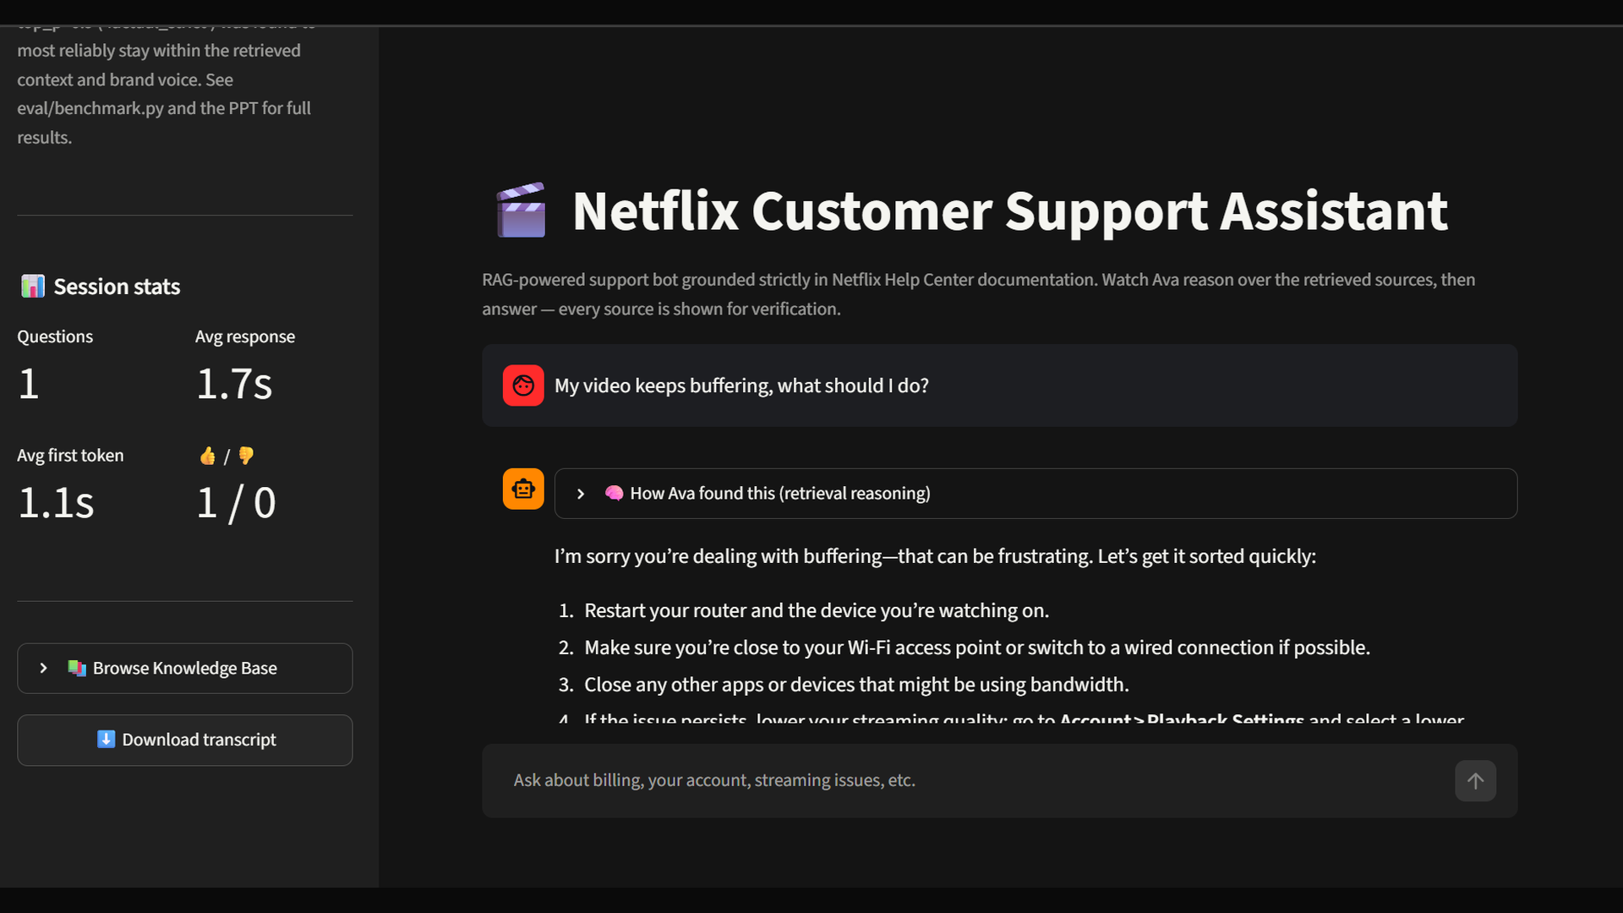
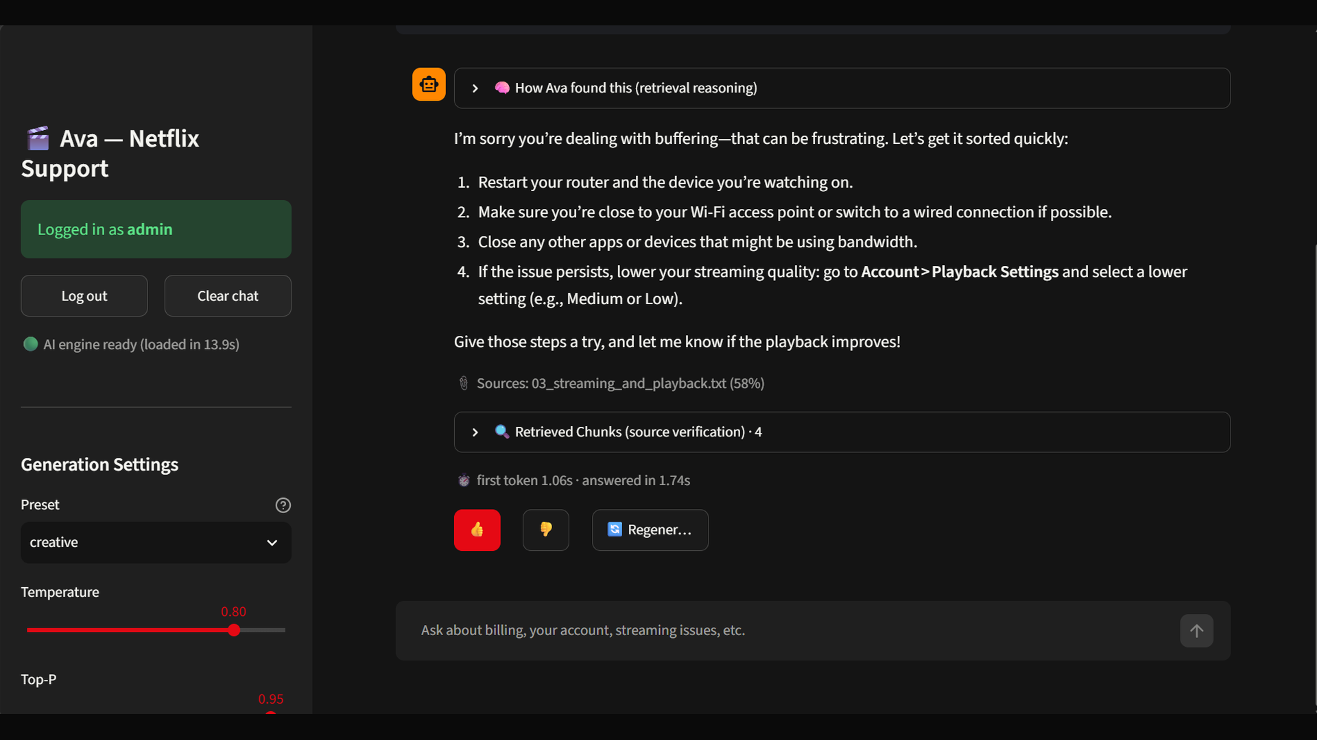
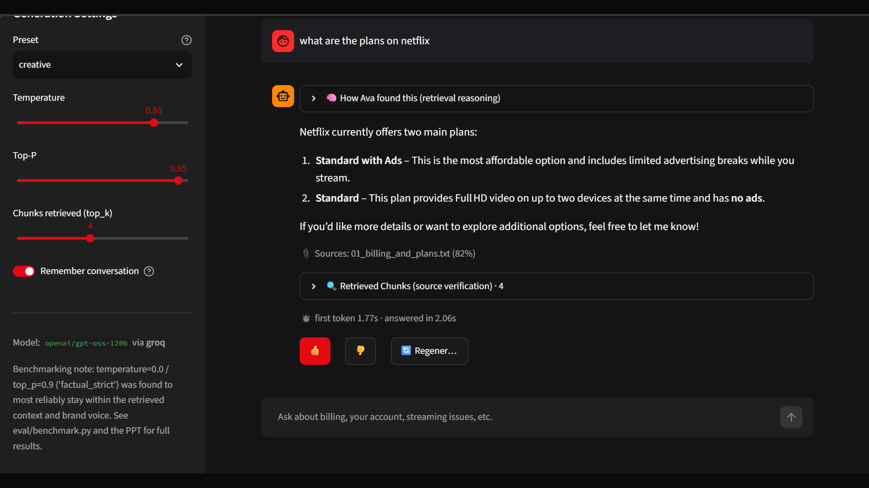
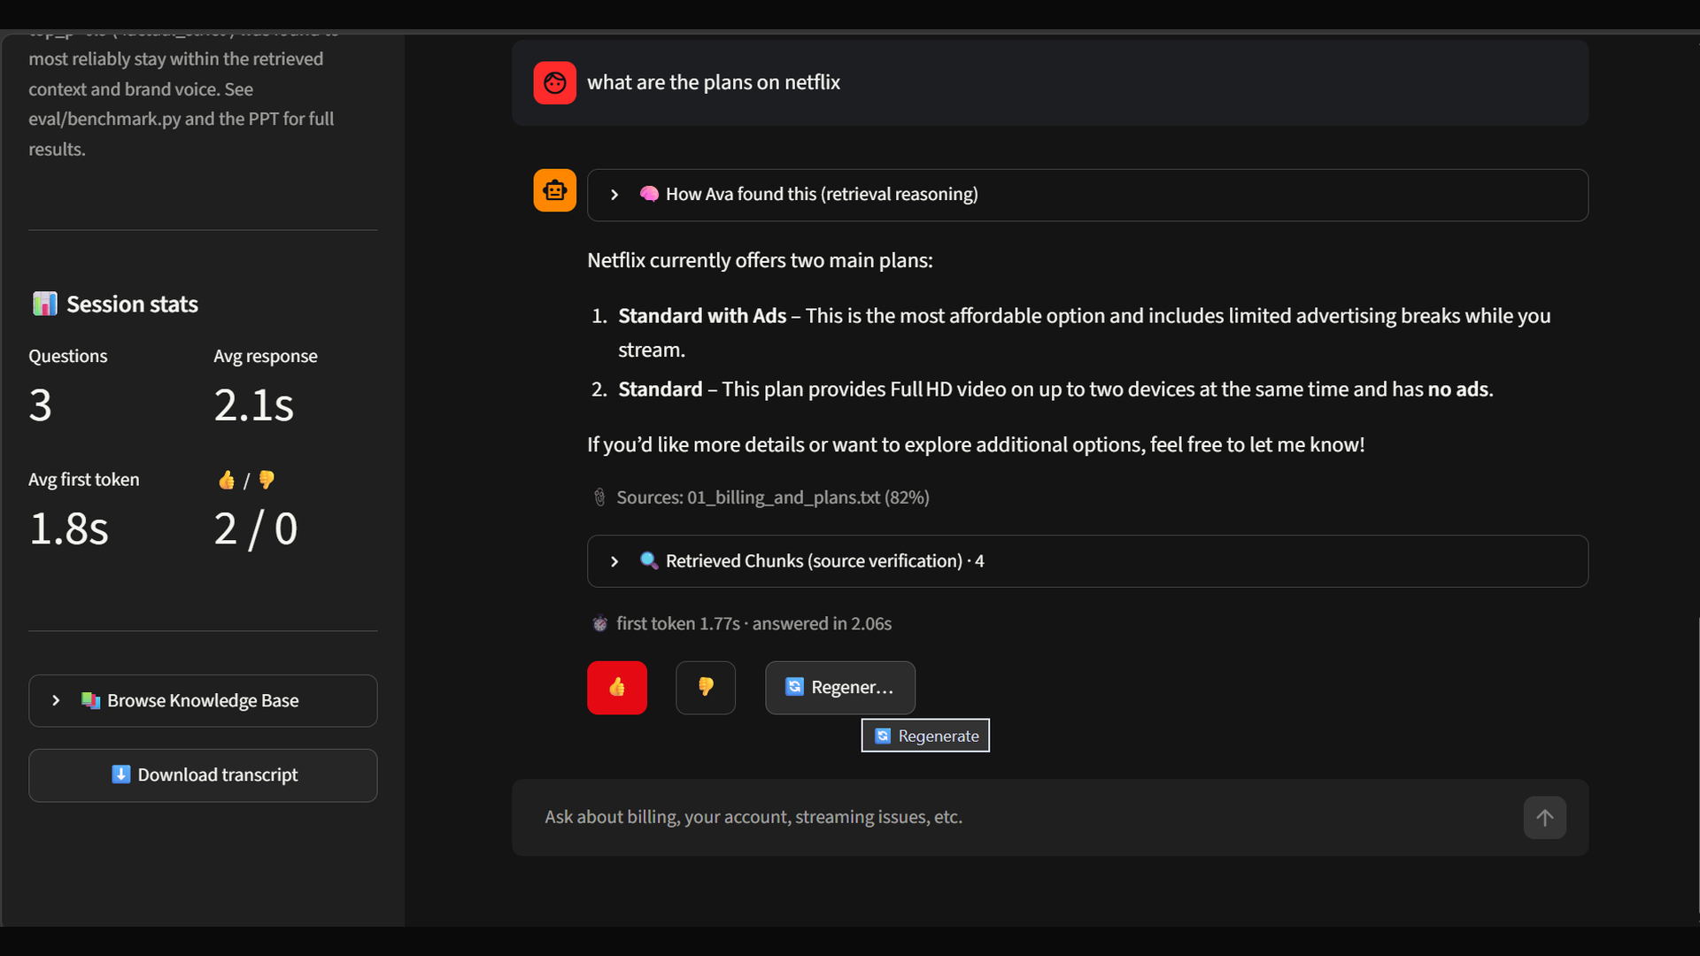
Streamlit Application Demo
APPLICATION DEMO
CLICK A SCREENSHOT TO ENLARGE
1
Retrieval reasoning panel and session stats
2
Logged-in session and generation settings
3
Sources, relevance score and model info
4
Session stats and feedback controls
Notes:
DEMO SLIDE
- Four screenshots from the running Streamlit app. In Slide Show mode, click any screenshot to enlarge it to full screen; click it again to return to the grid.
- 1) Chat view with the collapsed “How Ava found this (retrieval reasoning)” panel and the Session stats block (questions, average response time, average first-token time, thumbs up/down), plus Browse Knowledge Base and Download transcript.
- 2) Logged-in state (“Logged in as admin” after Mock Login), Log out and Clear chat buttons, and the Generation Settings (preset, temperature, Top-P). The answer shows its source file with a relevance score, a collapsed Retrieved Chunks panel (4 chunks) and first-token / total latency.
- 3) Sidebar settings (chunks retrieved top_k = 4, Remember conversation toggle, model openai/gpt-oss-120b via Groq) and a sourced answer citing 01_billing_and_plans.txt (82%).
- 4) Session stats after three questions, with the feedback (thumbs) and Regenerate controls.
- Talking point: the note in the app’s sidebar recommends factual_strict (temperature 0.0, top_p 0.9) for staying within the retrieved context and brand voice. These captures were taken with the creative preset selected (0.80 / 0.95), so say so explicitly or re-capture with factual_strict.
- PRESENTER CHECK: the Mock Login screen and an expanded Retrieved Chunks panel are not among these four captures; add them if you want those views shown. Never show API keys in screenshots.

Slide 10





Security & Responsible Access
SECURITY
User
Mock Login
Session state
RAG engine
opens the Streamlit app
credentials read from environment config
login status kept per browser session
retrieval + generation unlock after login
Mock Login is demonstration-grade. On its own it does not make this app production-secure.
IMPLEMENTED IN THE DEMO
PRODUCTION PATH (PROPOSED)
Mock Login gate in front of the RAG engine
Session-based access with env-configured credentials
System prompt: never request passwords, full card numbers or 2FA codes
Real identity provider (OIDC, SSO, MFA)
Managed secrets store; key rotation
Role-based access, audit logs, rate limits
Injection testing; prompt rules are not a hard security control
Notes:
SECURITY: DEMO VS PRODUCTION
- Implemented: a Mock Login screen gates the RAG engine; access is tracked in the Streamlit session; credentials come from environment configuration instead of being hard-coded; and the system prompt forbids asking customers for passwords, full card numbers or 2FA codes.
- Be clear that this is demonstration-grade. A session flag with a shared credential does not provide identity, authorization, auditing or protection against stolen sessions.
- Production path (proposed, not built): a real identity provider over OpenID Connect (Streamlit supports this natively via st.login), a secrets manager for API keys, role-based access control, audit logs and rate limiting, TLS, and adversarial testing for prompt injection and sensitive-information disclosure (OWASP Top 10 for LLM Applications).
- Note that instructions in a system prompt are behavioral guidance, not a security control; OWASP advises against relying on them as one.
- Never show real API keys or credentials in screenshots or slides.
- PRESENTER CHECK: confirm in the code that credentials are read from environment variables and that login state lives in st.session_state.

Slide 11






Evaluation Results
EVALUATION
PRELIMINARY · QUALITATIVE
EVALUATION SET · 7 QUESTIONS
EVALUATION LENSES
Grounding / refusal check (applied)
Latency across presets (observed)
Retrieval relevance, e.g. hit rate (to add)
4 answerable
should be answered from the KB
3 out-of-scope
should be refused, not guessed
Answer correctness vs. reference (to add)
Faithfulness to evidence (to add)
Grounding & refusal
Latency
Confidence
factual_strict passed the grounding/refusal check most consistently.
Comparable across presets; dominated by retrieval and the API call, not temperature.
Preliminary: 7 questions, qualitative scoring. Directional evidence, not a benchmark.
Notes:
EVALUATION DESIGN AND FINDINGS
- Test set: 7 questions, of which 4 are answerable from the knowledge base and 3 are deliberately out-of-scope. A good assistant answers the first group from the sources and refuses the second group instead of guessing.
- Finding 1 (author-reported): the factual_strict preset passed the grounding/refusal check most consistently.
- Finding 2 (author-reported): latency was comparable across presets, because it is dominated by retrieval and the API round trip rather than by temperature.
- Honesty: this is a small set with qualitative scoring, so treat it as directional. No accuracy percentages or latency figures are shown because none were provided.
- How to strengthen it: add retrieval metrics (did the right chunk appear in the top-k?), compare answers with reference answers, score faithfulness to the retrieved text, repeat runs, and enlarge the question set. Distinguish retrieval quality from generation quality when diagnosing failures.
- PRESENTER CHECK: if you have per-question pass/fail records or latency numbers, add them here as a chart or table and remove the 'PRELIMINARY' badge if the evidence supports it.

Slide 12
Conclusion & Future Roadmap
CONCLUSION
DELIVERED IN THIS DEMO
ROADMAP (PROPOSED)
Grounded answers from approved Help Center content
1
Quality
Retrieved chunks visible for verification
Expand knowledge-base coverage
Broaden evaluation coverage
Brand-voice persona with explicit refusals
Parameter experiment: T = 0.0 favored (preliminary)
2
Operations
Mock Login gate in front of the RAG engine
Monitor retrieval quality and faithfulness
Feedback loop: flag KB gaps from refused queries
CURRENT LIMITATIONS
Simulated knowledge base, 4 documents
7-question, qualitatively scored evaluation
Demo-grade authentication
3
Production
Human handoff integration
Real authentication replacing Mock Login
Notes:
CLOSING MESSAGE
- RAG constrains the support assistant to approved, sourced content; showing retrieved chunks makes every answer checkable; and a low temperature is a sensible default for factual support, as the preliminary experiment suggests.
- Be honest about limitations: simulated knowledge base, a 7-question qualitatively scored evaluation, and demo-grade authentication.
- The roadmap is proposed, not built: expand KB coverage and evaluation, monitor retrieval quality and faithfulness, add a feedback loop that turns refused queries into KB gaps, integrate human handoff, and replace Mock Login with real authentication.
- Invite questions.

Slide 13

References
SOURCES
CONCEPTS & PAPERS
DOCUMENTATION & SECURITY
Lewis et al. (2020)
Retrieval-Augmented Generation for Knowledge-Intensive NLP Tasks. NeurIPS. arXiv:2005.11401
Hugging Face
all-MiniLM-L6-v2 model card: 384-d vectors, 256 word-piece limit
Chroma docs
Embedding functions: default all-MiniLM-L6-v2, runs locally
Wei et al. (2022)
Chain-of-Thought Prompting Elicits Reasoning in Large Language Models. arXiv:2201.11903
LangChain docs
RecursiveCharacterTextSplitter: size measured in characters
Holtzman et al. (2020)
The Curious Case of Neural Text Degeneration (nucleus / Top-P sampling). ICLR. arXiv:1904.09751
Groq docs
openai/gpt-oss-120b model page: MoE, 131K-token context
Streamlit docs
User authentication with OIDC: st.login, st.user
Reimers & Gurevych (2019)
Sentence-BERT: Sentence Embeddings using Siamese BERT-Networks. arXiv:1908.10084
OWASP
Top 10 for LLM Applications 2025: prompt injection, data disclosure
Documentation describes the technologies used; it does not validate results measured by this project.
Notes:
SOURCES
- Technical claims about the tools (embedding dimensions, default embedder, splitter behavior, model architecture and context window, authentication options, LLM security risks) come from the official documentation listed here.
- External documentation does not prove anything about this project's measured results; those come only from the project's own evaluation.
- The arXiv papers are cited for the concepts (RAG, chain-of-thought prompting, nucleus sampling, sentence embeddings).

